Slide 1
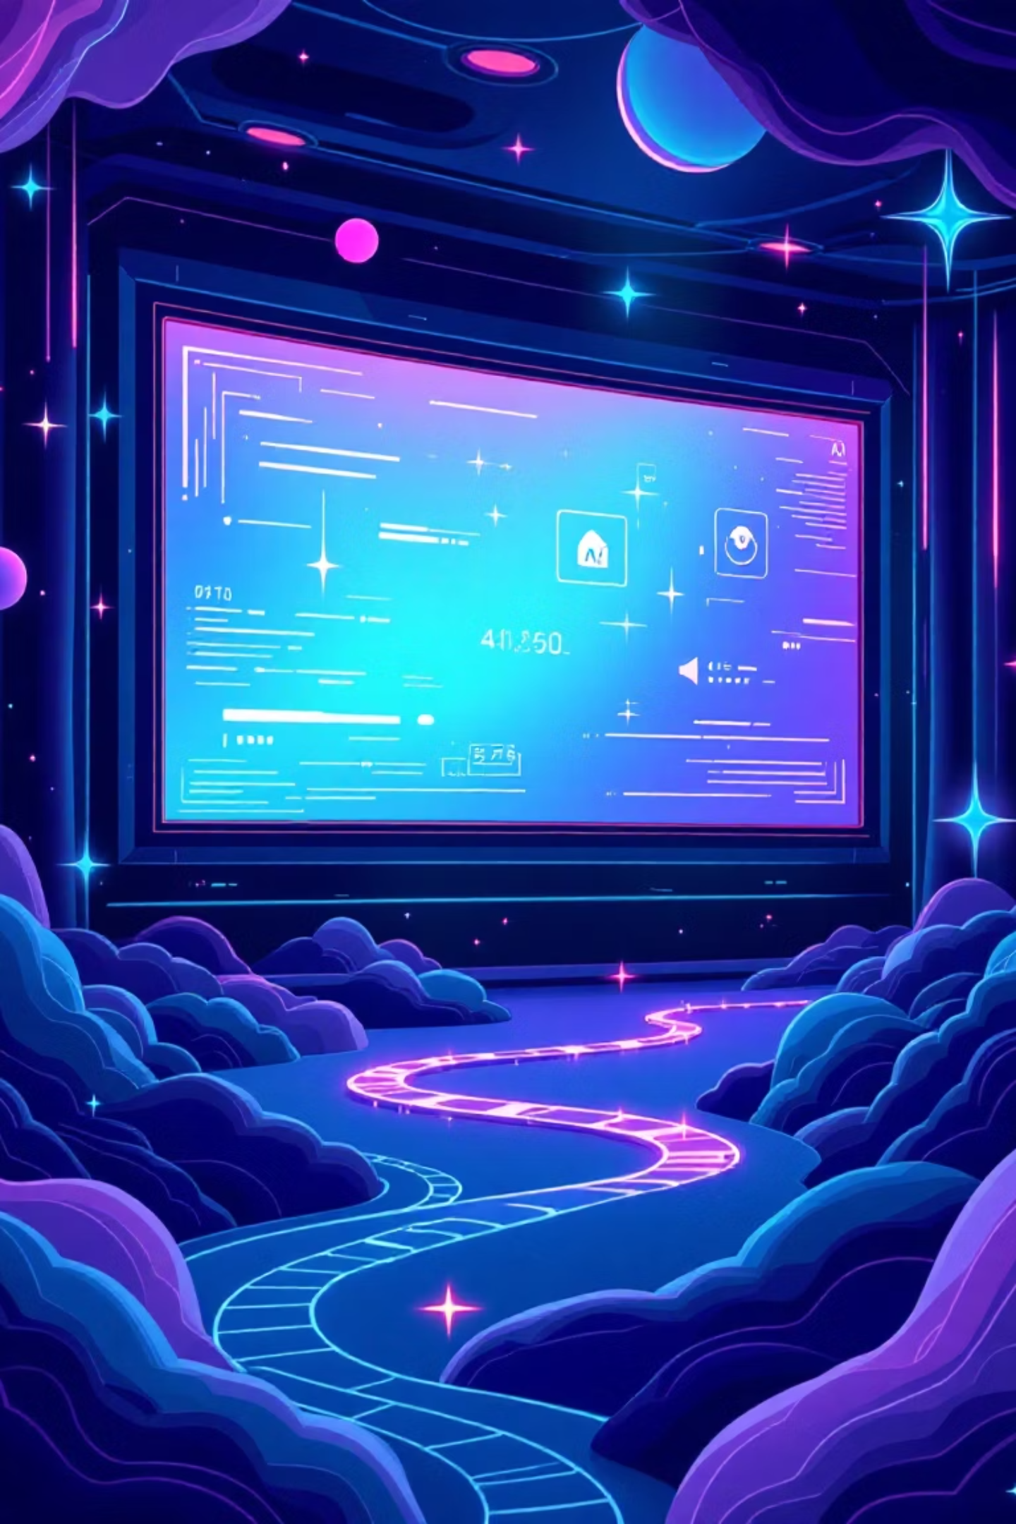
Movie Recommendation System Based on Genres
AI-Powered Content-Based Filtering using TF-IDF & Cosine Similarity

Slide 2

The Problem: Navigating Vast Movie Catalogues
Decision Fatigue
Lack of Personalisation
Time-Consuming Search
Users overwhelmed by extensive movie choices.
Platforms offer broad selections without tailored guidance.
Manual browsing leads to inefficient and often unsatisfactory selections.
Our goal: intelligent recommendations matching user preferences.

Slide 3
Project Objectives: Crafting a Smart Recommender
Genre-Based Recommendations
Content-Based Filtering
TF-IDF Vectorisation
Transform genre text into numerical vectors.
Suggest movies aligned with genre similarity.
Utilise core principles of content analysis.
Cosine Similarity Metrics
Top N Recommendations
Measure precise movie similarity.
Present best matches with scores.

Slide 4
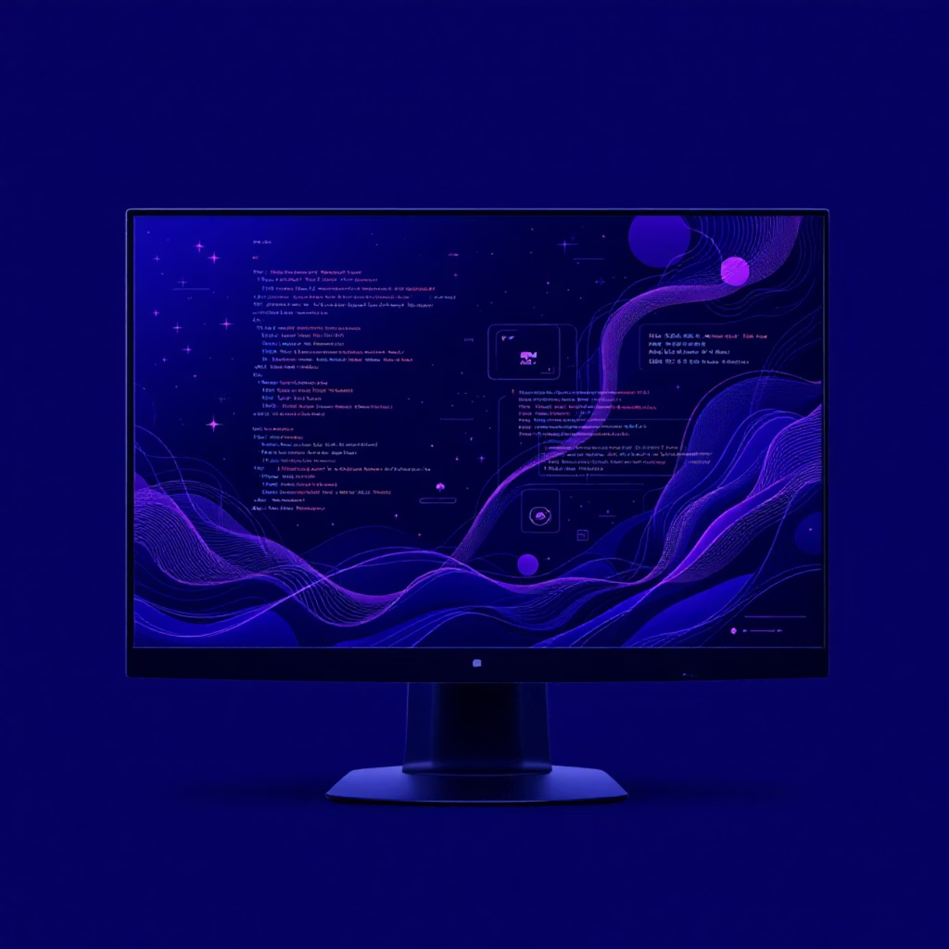
Technology Stack: Building the Recommendation Engine
Frontend Development
UI Components
React, TypeScript, Tailwind CSS
Shadcn/UI, Lucide Icons
Core Algorithm
Build Tool
TF-IDF Vectorisation, Cosine Similarity
Vite
Styling
Custom Dark Cinematic Theme

Slide 5
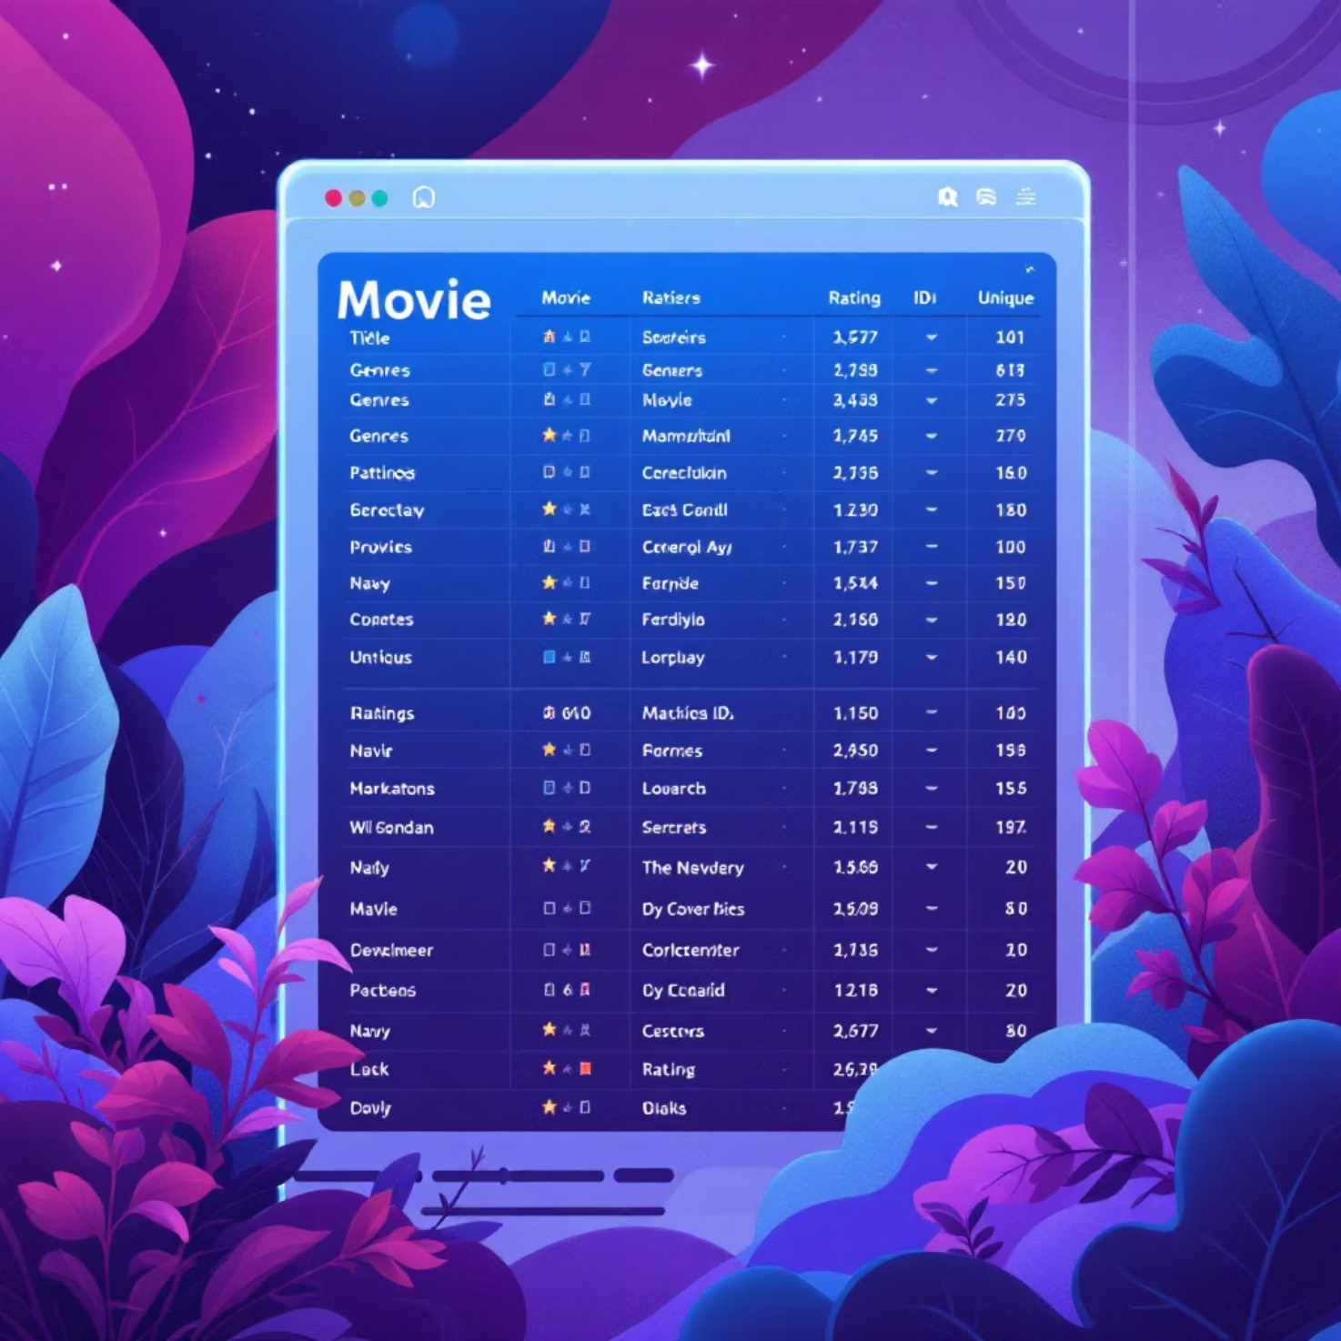

Dataset Overview: The Foundation of Our System
Key Data Columns:
movieId: Unique identifier
title: Movie name
genres: Pipe-separated (e.g., Action|Sci-Fi)
year: Release year
rating: User rating (1-10)
Sample: 30 movies across 15+ diverse genres including Action, Drama, Sci-Fi, Romance, Thriller, Comedy.

Slide 6
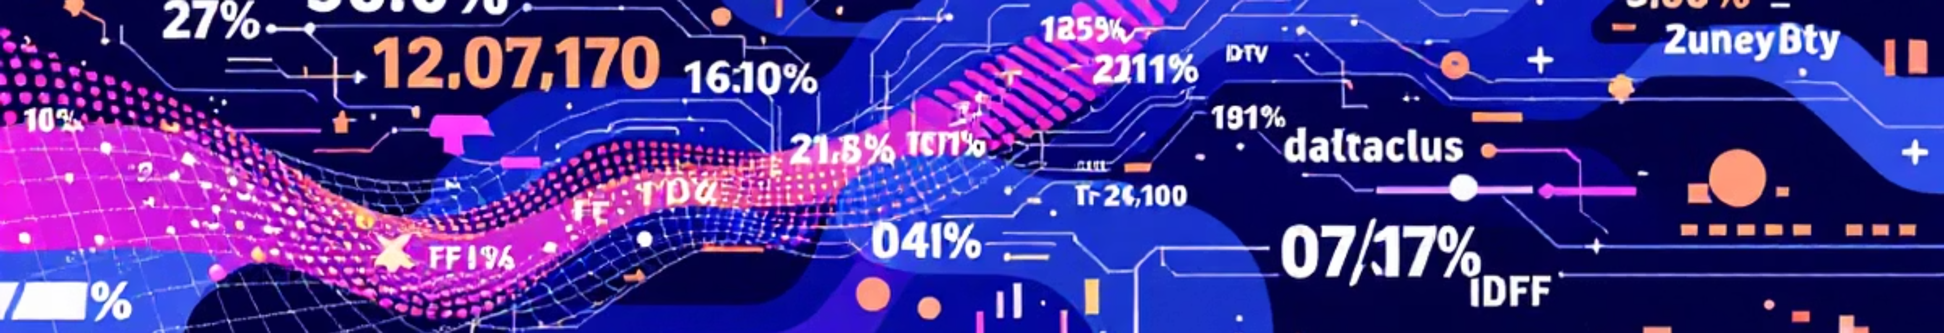
TF-IDF Vectorisation: Unpacking Genre Importance
Term Frequency (TF)
Inverse Document Frequency (IDF)
TF-IDF Score
Measures genre prevalence in a single movie:
Highlights distinctive genres:
Quantifies genre rarity across all movies:
TF-IDF = TF × IDF
TF = (Genre count in movie) / (Total genres in movie)
IDF = log(Total movies / Movies with this genre)
Higher score signifies a more unique and relevant genre.

Slide 7

Cosine Similarity: Pinpointing Movie Matches
Measures the angle between two movie vectors in a multi-dimensional genre space, indicating their similarity.
Similarity Formula:
Similarity = (A · B) / (||A|| × ||B||)
1.0: Identical genre profiles, perfect match.
0.0: No common genres, complete dissimilarity.
0.5: Moderate similarity, some shared genres.
Movies with the highest similarity scores are selected for recommendation.

Slide 8
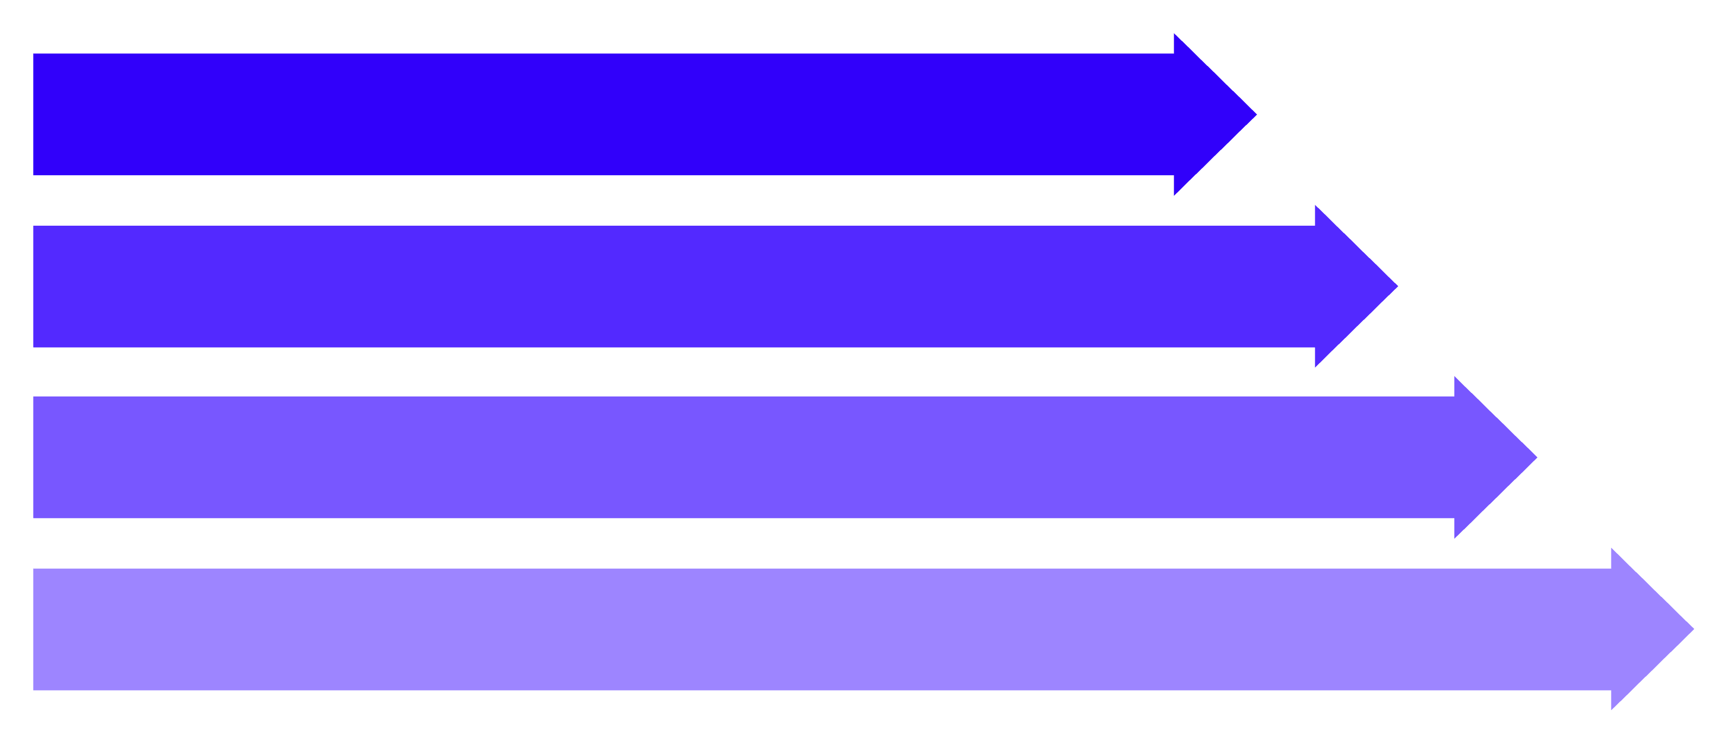
System Architecture: From Input to Recommendation
User Input
Genre / Click
TF-IDF Vectorize
Cosine & Sort
A seamless pipeline for personalised movie discovery.

Slide 9
Key Features & User Interface
Search Functionality
1
Efficiently filter movies by title.
Genre Filtering
2
Interactive badges for preferred genre selection.
Click-to-Recommend
3
Instant recommendations from any selected movie.
Similarity Scores
4
Visual display of recommendation match percentage.
Dark Cinematic Theme
5
Premium, immersive aesthetic.
Responsive Design
6
Optimal viewing across all devices.

Slide 10

Conclusion & Future Scope
Achievements:
Future Enhancements:
Successful content-based filtering.
Integrate movie posters and trailers.
Real-time TF-IDF + Cosine Similarity recommendations.
Implement collaborative filtering (user ratings).
Intuitive, visually appealing user interface.
Expand dataset to 1000+ movies.
Add user favourites with persistence.

